Slide 1
MOTIVATING AUDIENCES TO OVERCOME CHALLENGES AND ACHIEVE GREATER VICTORY!
MATT JONES
3-TIME CANCER CONQUEROR, 8 CONTINENT MARATHON MAN
Motivational Leadership Keynote Speaker

Slide 2
WHY MATT GETS BOOKED BY ORGANIZATIONS AROUND THE WORLD
INSPIRING STORY
ACTION STRATEGIES
“I like to hold the attention of the audience through the power of my story over insurmountable odds.”
-MATT JONES
From Matt’s experience of conquering cancer to completing marathons around the world, audience s are captivated by his dynamic stories.
“Matt’s presentation was outstanding! He has a phenomenal and inspiring story, which he presents in a dynamic and memorable way.”
-Steve Liechty, Wyoming Recreation and Parks Association Conference Chair
“I like to share with people practical strategies that they can apply immediately to their live & work.”
-MATT JONES
From developing greater resilience to living with greater passion, Matt shares practical strategies that can be used to overcome challenges and achieve greater success.
“Our members were inspired, entertained, and left at the end of the day with key principles they can use in their everyday lives. I strongly recommend him as one of the best speakers in our 22-year history.”
-Washington State Council for Affordable and Rural Housing

Slide 3
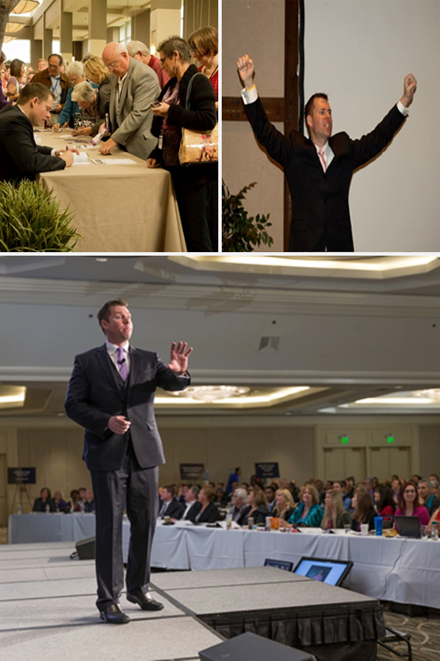
HOW MATT JONES WILL MAKE YOUR NEXT MEETING MEMORABLE & MOTIVATIONAL
LIFE-CHANGING STORY
Matt Jones has an inspiring story of overcoming insurmountable odds that will motivate your attendees to discover a greater potential within them.
PROVEN STRATEGIES
Matt shares real life strategies he used to overcome adversity and achieve greater victory, that your attendees can also use
Matt also shares psychological tools based off scientific research from the field of Positive Psychology.
VALUE
Valuable strategies that can be applied immediately and last lifetime
Action steps offering an easy to follow path to success
Lasting impact that bring about long term results
Useful solutions relevant to unique needs of your group
Easy to work with

Slide 4
WHAT TOP LEADERS ARE SAYING ABOUT MATT JONES’ MOTIVATING KEYNOTE TALKS
“Matt Jones is a true champion and his story inspires others to be a true champion.”
-George Brett
World Series Champion, Hall of Famer
“Matt Jones is a gifted speaker and a master at motivation. Thank you, Matt, for sharing you remarkable story. Your message and passion will inspire audiences everywhere to achieve their own limitless success.”
-Barbara Niven
TV Icon and Actress
“Great job, Matt.”
-Bill Self, Head coach Kansas Jayhawks,
2008 NCAA Men’s Basketball National Champions
“Matt Jones is a speaker who entertains, enlightens, and creates an unforgettable experience for the audience.”
Joe Theismann
Legendary Quarterback, Super bowl Champion
“Matt has a wonderful ability to inspire and motivate you to overcome any obstacle and achieve any goal.”
-Brian Tracy
Top selling author of over 45 books
“Matt Jones at a young age tapped into the universal power that is available to all. His story is proof of what is possible for our lives. He has a transformational message that is life changing.”
-Dr. Catherine Ponder, One of America’s foremost inspirational authors

Slide 5
MATT’S STORY HAS BEEN FEATURED IN NUMEROUS MEDIA SOURCES...
t
AND MANY MORE…

Slide 6
MATT IS A LEADING AUTHORITY...
OVERCOMING ADVERSITY
POSITIVE PSYCHOLOGY
MOTIVATION
HE HAS SPOKEN FOR ORGANIZATIONS
IN SEVERAL INDUSTRIES...
Banking/Finance
Education
Engineering
Insurance
Government
Healthcare
Non-profit
Property Management
Public Safety
Real Estate
Technology
Travel

Slide 8
LIFE’S A MARATHON: HOW TO OVERCOME ADVERSITY AND ACHIEVE GREATER VICTORY
How do you keep motivated when faced with adversity? This is an important question for leaders of successful organizations. What happens when change, burnout, or stress threatens continual growth? How do increase productivity through passion and perseverance?
In this talk, Matt provides solutions based on his experience of conquering cancer three times, surviving a bone marrow transplant, and completing eight marathons on eight continents.
YOUR AUDIENCE WILL LEARN:
Three ways to overcome adversity
The number one predictor of success
How to thrive in the midst of change
Psychology tools for immediate and lasting success
“Matt’s story was a great fit for the nearly 2,000 attendees. He empowered, encouraged, and inspired the audience. . . Matt Jones is a top-notch speaker who brings great value and an unforgettable story of the triumph of the human spirit.”
-Reed Pew
CEO and President, American Academy of Professional Coders

Slide 9
SALES IS A MARATHON: HOW TO STAY MOTIVATED IN SALES
Success in sales, like a marathon, is an endurance event. In this motivating talk, Matt Jones shares how salespeople can persevere, thrive through adversity, and to stay motivated against all odds. A common response after hearing Matt’s talk is “if Matt can go through all he went through the rejection I face is nothing.”
This talk is ideal for sales groups, associations, and organizations looking to give their salespeople that extra edge that will allow them to outlast and outperform the competition and thrive in a challenging economy.
YOUR SALESPEOPLE WILL DISCOVER HOW TO:
The one factor they need to stay motivated
How to operate from the mindset of GRIT
Strategies to keep their passion for sales
How to stay engaged for maximum productivity
“Matt's talk inspires, encourages, and empowers you to reach your highest potential as a salesperson. Give your sales team a competitive edge by having Matt Jones come and speak to them.”
-Cory Stepanek,
CLTC, Geneworth Financial

Slide 10
LEADERSHIP IS A MARATHON: HOW TO STAY MOTIVATED AS A LEADER
In a recent survey 75% of respondents said their company is chronically short of leadership talent (War of Talent). Being an effective leader like a marathon is an endurance event. Matt’s talk, “Leadership is a Marathon” provides principles that leaders can use to empower, energize, and inspire themselves in order to do the same for those they lead.
Matt uses his experience of running a marathon as a metaphor to share leadership strategies learned through personal experiences and graduate work in Transformational Leadership.
YOUR LEADERS WILL WALK AWAY WITH:
The four characteristics that REAL leaders practice
How to have a greater influence and impact on those you lead
Renewed passion for leading others
The number quality of leadership
“Matt was instrumental in us delivering one of the best Leadership Conferences in 14 years to over 500+ associates. I would highly recommend Matt as a speaker for any upcoming event.”
- Annie McClinton,
VP Training and Development, Western National Group

Slide 11
HAPPINESS IS A MARATHON: HOW TO STAY HAPPY IN LIFE AND WORK
According to the latest research, the majority of people are unhappy at work. Matt Jones’ brand new talk, provides strategies that can be applied immediately and lead to lasting levels of happiness.
Your attendees will discover from Matt’s experiences and the field of Positive Psychology, how they can increase productivity and resilience, while lower levels of stress.
YOUR AUDIENCE WILL GAIN THE FOLLOWING BENEFITS:
Discover how to reduce anxiety
Learn how to increase resilience
Experience revitalization through practicing happiness techniques
Walk way with proven psychology tools to increase one’s happiness in life and at work
“We could not have asked for a better choice of a keynote speaker. He got us to laugh, get out of our seats, and absorb his wisdom.”
-Karen J. Wilson
Alabama Health Information Management Systems Society

Slide 12
MATT TAILORS EACH TALK TO YOUR SPECIFIC MEETING NEEDS
Matt ensures that each talk will address the issues and needs that your meeting is wanting to address. His goal is to meet the objectives that you have for your meeting. Matt Jones is skilled in the ability to tailor his talk to fit your specific goals.
Based on your meeting or event, Matt will tailor his talk in order to create an one of kind unique and memorable experience for your attendees. Matt is committed to delivering;
A motivating keynote that keeps the attention of your group while offering specific tools that can be applied immediately.
Energetic, inspiring, and transformative experience.
Practical action steps to be taken by your group that lead to results.
TAILORED TALK THAT MOTIVES YOUR UNIQUE NEEDS OF YOUR MEETING.
“His against all odds story resonated with our group and provided real life examples of handling the stresses/challenges especially as we work with patients and healthcare providers.”
-David A. Nye, Chairman, Education Committee, Georgia Medical Group Management Association
“Our members were motivated and heard key strategies they can apply to their personal situations.”
-Margaret L. Barnes,
International Right of Way Association
“We were looking for a speaker that would not only inspire our managers but also provide practical strategies they could us at their properties. Matt fulfilled both wonderfully with a presentation that integrated our company’s core values and made it feel like it was just for us.”
-Lee Schwendiman,
Dei Communities, Vice President, Revenue Management

Slide 13
MATT HAS AUTHORED NUMEROUS BOOKS READ AROUND THE WORLD
Going Through Hell? Don’t Stop!
Life’s a Marathon: 26.2 Ways Stay Motivated in Life
101 Timeless Truths
Sales is a Marathon: 26.2 Ways Stay Motivated in Sales
Leadership is a Marathon: 26.2 Ways Stay Motivated in Leadership
189 Victory Strategies
Cancer is a Marathon: 26.2 Ways Stay Motivated
Meeting Planning is a Marathons: 26.2 Ways Stay Motivated as a Meeting Planner
Nursing is a Marathon: 26:2 Ways Stay Motivated as a Nurse
Life’s is a Marathon: 3 Unique Choices to You Can Use to Overcome Adversity and Achieve Greater Victory in Your Business, Leadership and Life
Happiness is a Marathon: 26.2 Ways to Be Happier at Work and in Life

Slide 14
WHAT MEETING PLANNERS ARE SAYING ABOUT MATT’S MOTIVATIONAL STORY AND TALK OVER INSUMOUNTABLE ODDS
“He inspired, wowed, and transformed the over 500 of our members in attendance. His story was a great example for our members to follow when faced with daily challenges.”
-Kathy Roberson,
Mississippi Association of School Business Officials
“Terrific! His presentation was a homerun performance. He provided a full hour’s worth of energy-packed entertainment, encouragement, and education. I received nothing but praise about Matt’s inspiring talk. The strategies Matt shared contained lifelong value that can be put into practice immediately.”
-Marie T. Mercer
Virginia Executive Director, National Association of Insurance and Financial Advisors
“I was really excited to have Matt Jones' help in kicking off the year... His one day leadership training was the perfect to motivate & inspire the REALTORS®... He provided countless strategies full of value and lasting benefits for our leaders. Matt Jones is a high octane presenter & completely kept the attendees engaged throughout the day.”
-Joni C Schneider
Past President, Alaska Association of REALTORS®
“Matt Jones provided the perfect talk for our members. His story also provided the powerful reminder of the importance of what we do and the difference we make in the lives of the patients. I have received tremendous feedback about Matt’s presentation and know provided value to all that were in the room.”
-Douglas Gish,
Minnesota Healthcare Engineer
Association Conference Chair

Slide 15
WHAT DOES IT MEAN TO BE THE EIGHT CONTINENT MARATHON MAN
Being the Eight Continent Marathon Man means that Matt Jones has completed eight marathons on eight continents. He has completed the San Diego Rock ‘N Roll Marathon, Rome Marathon, Tokyo Marathon, Perth Marathon, Cape Town Marathon, White Continent Marathon in Antarctica, and the Punta Arenas Marathon in Chile. Matt completed his eighth marathon on the newly discovered continent of Zealandia in New Zealand.
Only one tenth of one percent of the population has completed a marathon. Less than 300 people have completed a marathon on seven continents.
Even more remarkable, Matt completed eight marathons on eight continents after conquering cancer three times, surviving a bone marrow transplant, and relearning how to walk.

Slide 16
MATT IS A WORLD CLASS ACHIEVER IN OVERCOMING ADVERSITY AND CHANGE
THREE-TIME
CANCER CONQUEROR
BONE MARROW
TRANSPLANT SURVIVOR
COMPLETED EIGHT MARATHONS ON EIGHT CONTINENTS AFTER RELEARNING HOW TO WALK
“Matt Jones has done what anyone
would consider impossible.
Conqueror. Overcomer. Champion. Superhuman.
None of those words do him justice."
-Scott Hamilton, Olympic Gold Medalist

Slide 17
WHY MATT IS THE IDEAL SPEAKER FOR YOUR NEXT MEETING
Matt is committed to providing a world-class talk that will empower, educate, and energize your group. Matt is irrationally passionate about sharing his story and the lessons learned from overcoming impossible odds.
A testament to Matt’s effectiveness is the fact he has spoken to audiences across multiple industries. His story is one that resonates with those seeking to achieve greater success personally and professionally.
Three-Time Cancer Conqueror
Completed Eight Marathons on Eight Continents
Author of 11 books
Inspiring story of overcoming insurmountable odds
Shares solution orientated strategies based on scientific research
Captivating and humorous storyteller
“Matt Jones proved to be a phenomenal closing keynote for our conference this year. He was exactly what we were looking for to conclude our conference with positivity and high energy! He did an excellent job of weaving his highly inspirational personal story along with practical and life-changing strategies for our attendees to take with them.”
-Sarah Carter,
Meeting Planners International
Cascadia Educational Conference Chair

Slide 18
WHAT CLIENTS SAY ABOUT BOOKING MATT
IMPACTFUL, INSPIRING, AND MOTIVATINOAL
“Matt is very inspirational and he deeply touches and encourages others
Through his story.”
-Sheryl Korn, Amway
PRACTICAL SUCCESS STRATEGIES
“Matt shares practical keys to success, which cause the small first steps of real change, creating a snowball of positive successes.”
-Sandee Muro
California Medical Staff Services
“You made a real difference in our members... The attendees... walked away with valuable strategies they can apply. You are a spellbinding speaker that touches the hearts and minds of those who hear you speak.
-Susan Bauman
CAI-NV Education Chair
LASTING VALUE
“Matt delivered a highly charged, motivational, life-changing presentation.”
-Ryan Swinney,
Montana Association of REALTORS®
“Listening to Matt was a great reminder of the importance of our work. He made a lasting impact on our members and has our full recommendation as a speaker.”
-Stephen Slack,
Program Chair, Pennsylvania Association of Cancer Registrars

Slide 19
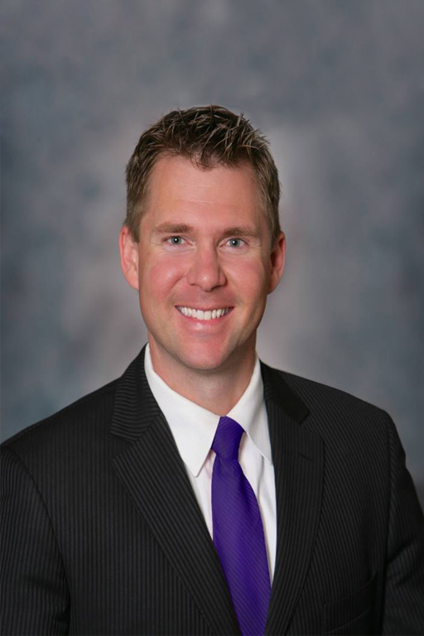
MATT’S PERSONAL STORY
Matt Jones was extremely shy as a kid. His kindergarten teacher said that Matt was very quiet & she was concerned.
Being diagnosed with cancer during his senior year of college became a life changing event for him. At one point he was told that he had a less than ten percent chance of living to the age of thirty. He believes that out of your mess comes your message and out of your test comes your testimony. From that his experience, Matt made it is mission to motivate to others to overcome the challenges them face and achieve greater victory.
To learn more about Matt and his story please visit his website: www.MatthewDJones.com
Matt’s Message to You:
I’m irrationally passionate about sharing my story and the lessons I learned to motivate others. It would be an honor to work with you and your group. I’m committed to providing the best I have to making your meeting an amazing success with lasting value for your attendees.
Matt Jones

Slide 20
LET’S WORK TOGETHER
Contact Justin Crow today to book Matt Jones for your next meeting or event.
Justin Crow
Justin@MatthewDJones.com (213) 291-9873
As Matt travels often. Please contact Justin to check Matt’s availability or questions you have about him speaking at your next meeting or event.

